Slide 1
First Byte -
Vancouver City FC
Presented by: Vincent Luong, Bowen Cui, Min Cho, David Huang

Slide 2

TOC
Overview
Concerns
Proposed Solution
Projected Financial statements

Slide 3
Overview - The League
Current Situation
Bolt Soccer League
Maintain Stadium
Core Values
Core Values
Community and Belonging
Our Tasks
Business Through Data-Driven Approach
Maintain and expand on Local/Global Fanbase
Data Cleaning
Identify Anomalies in the Dataset
Dealing with Missing Values

Slide 4
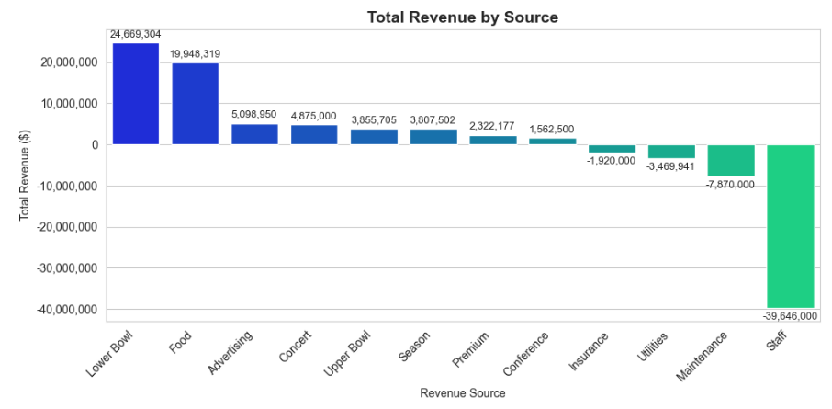
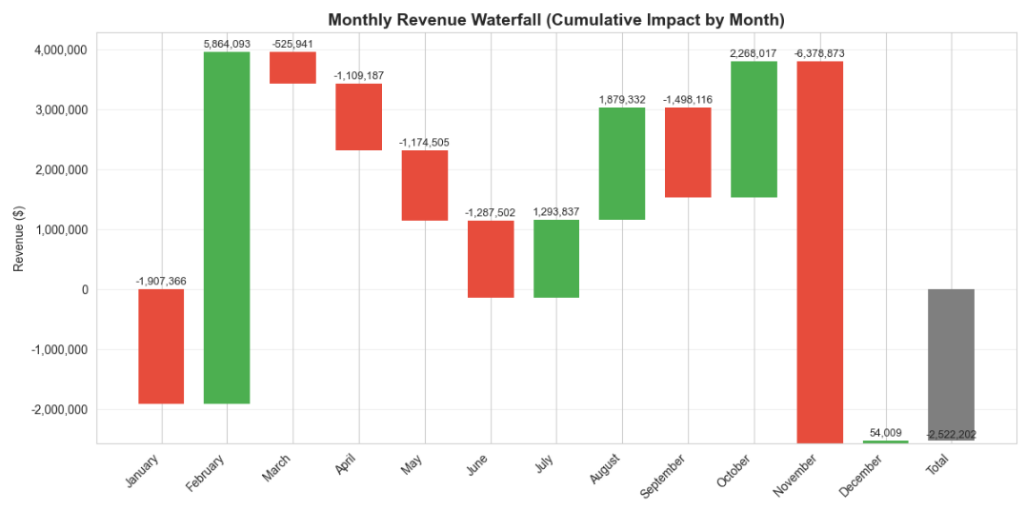
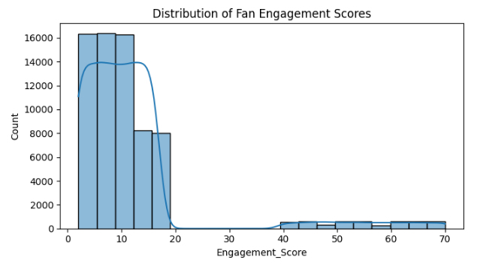
Concerns:
Slower Fan Engagement
Inconsistent Revenue Streams
Stadium Areas Not Maximized
Continue to draw in new audiences towards the stadium
Increase revenue streams
Increase fan engagement domestically and internationally
Fan Engagement = (Games Attended * 2) + (Season_Pass + 10)

Slide 5
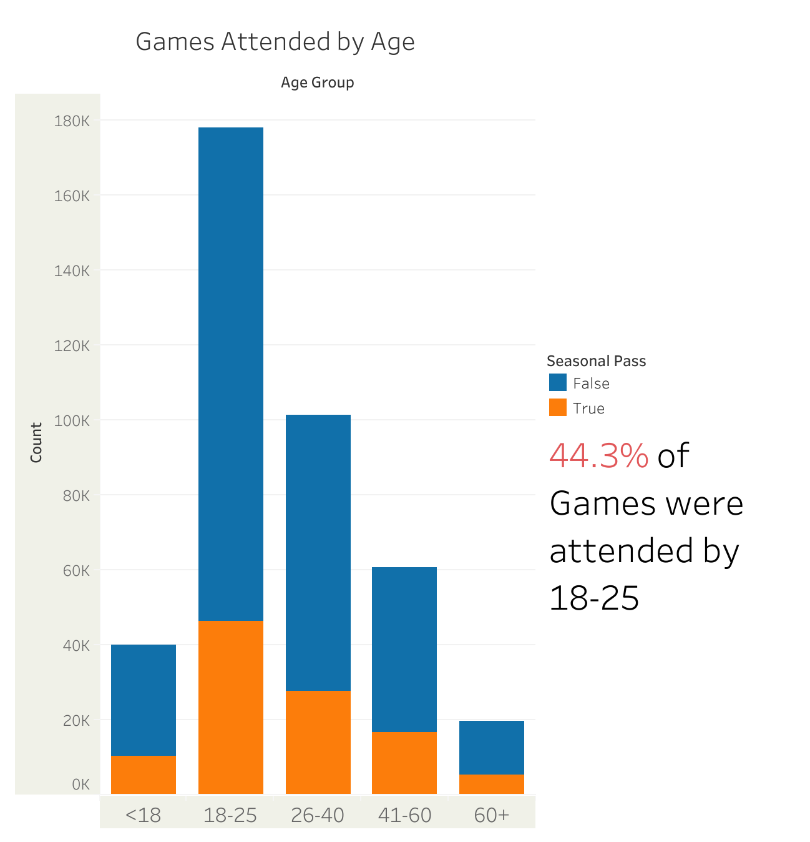
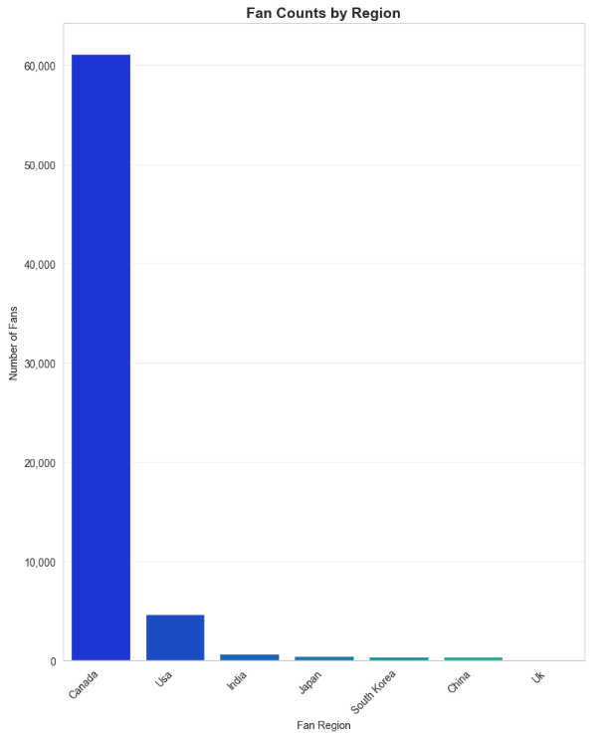

Slide 6
Fanbase
Target Youth/University Students
Provide discounted season pass
Interactive on-campus events/booths
Volunteering opportunities during games
International Engagement (primarily USA)
Watch-party events at sports bars
Live TV broadcast + streaming partnerships
1
3
Social Media Engagement
Produce TikTok/Instagram content
Trends, dances, challenges, live Q&A, etc
Example: Formula 1’s Grill the Grid
Road Tour (Canadian regions)
Offseason road tour to different cities
Games, merch, meet-and-greets, etc.
2
4

Slide 7
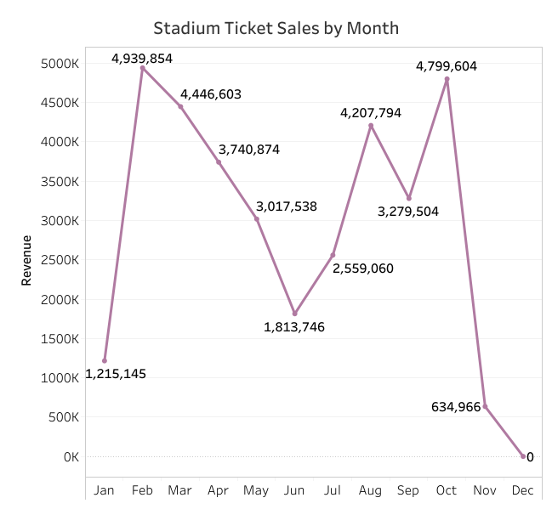
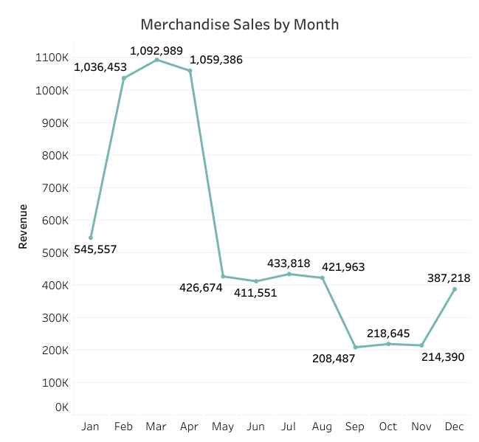
Merchandise
Stadium Ticket sales = Lower Bowl Seats + Upper Bowl Seats + Premium Seats + Seasonal Pass

Slide 8
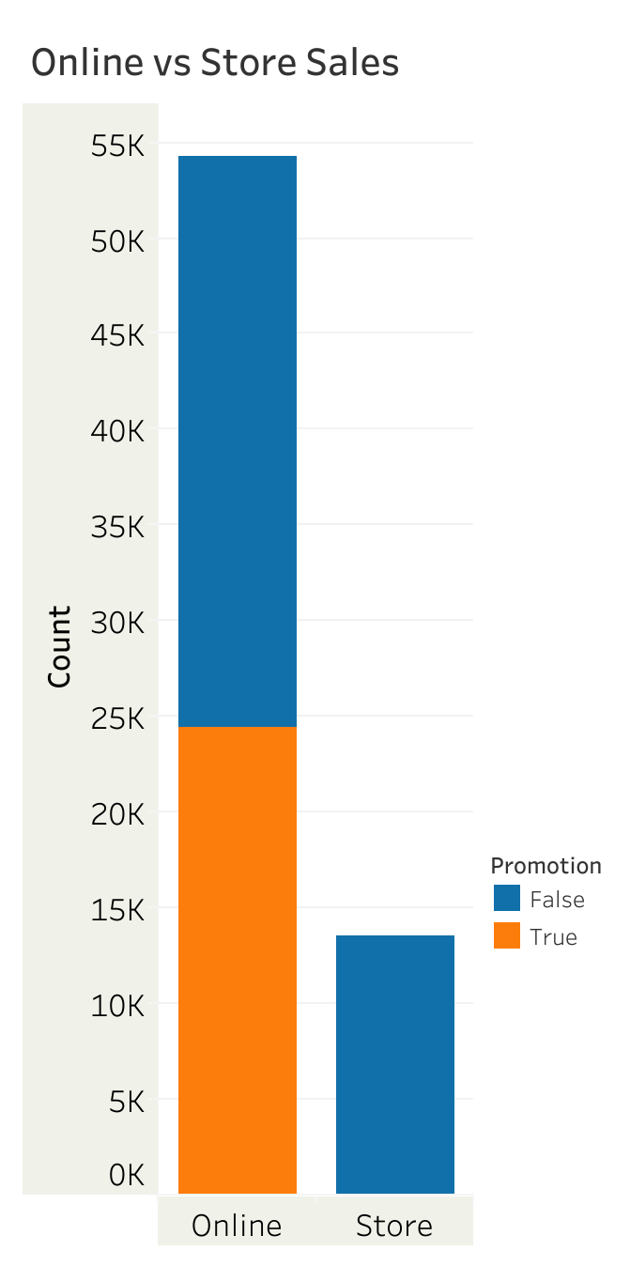
Merchandise
We are not utilizing foot traffic in stadium well enough…
Exclusive Merch in each Quarter
Limited Edition Merch to Drive Quarterly Sales
“Ticket - Youth Merch Bundle”
Young fans buying match tickets get exclusive 15% off on youth clothing in store
1
3
“Enjoy 5% off all in-store purchases!”
Drives In-Person Stadium Engagement
2

Slide 9
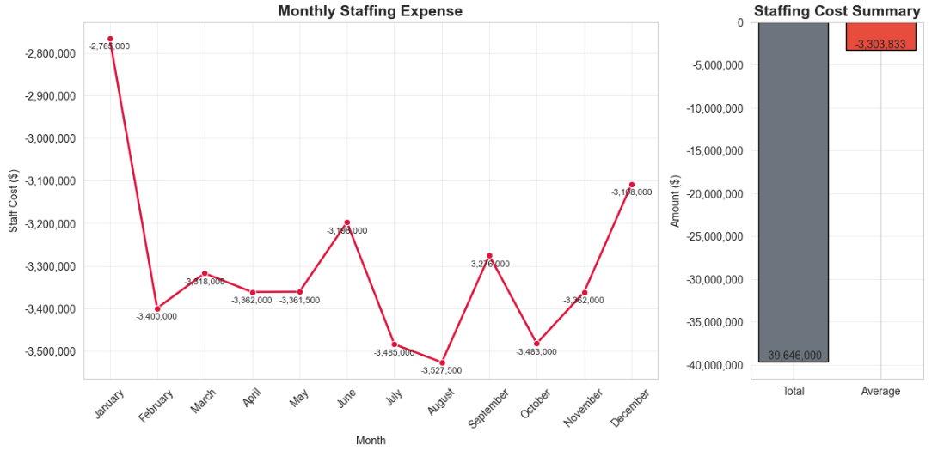
Stadium Operations - Staffing

Slide 10
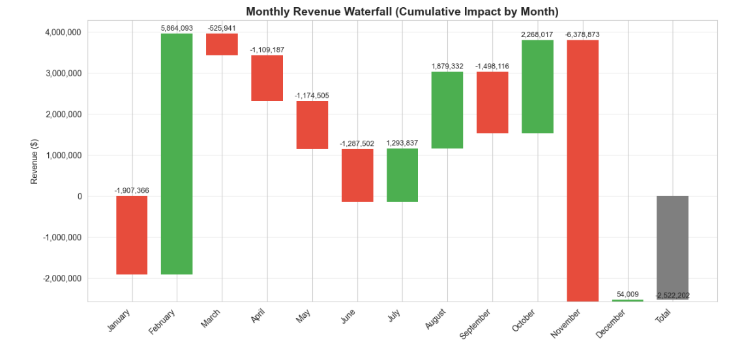
Stadium Operations - Renovation
Notes:
Show that massive maintenance costs are costing us in january and november

Slide 11
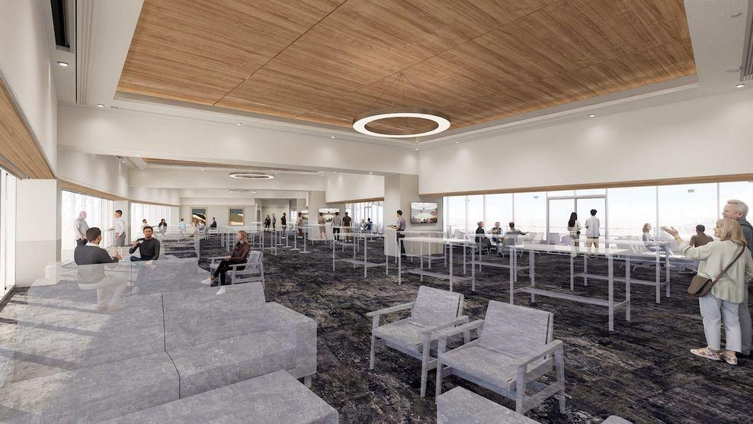
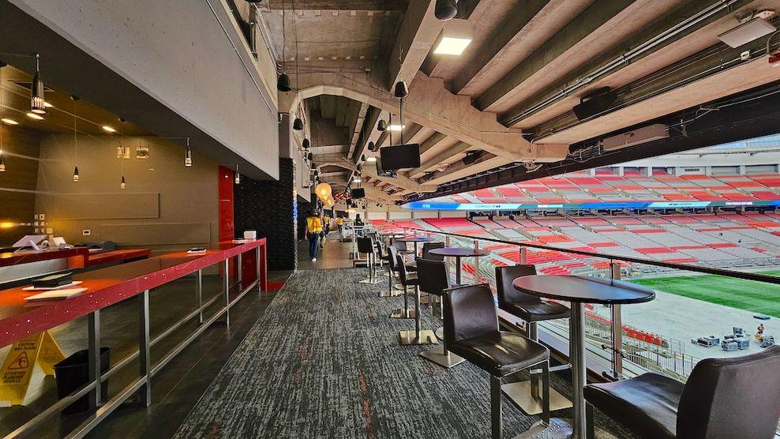
Proposed Renovation Plan
Using BC Place as a guideline, we will put our initial budget at 150 million:
Includes renovation to amenities, such as
50 new Premium Seating booths (to boost our current 7.2%** premium revenue)
New amenities and utilities
Main upgrades/renovation will take place in November to January
** Calculations and Formulae
Notes:
Timeline: renovations set to 2 years

Slide 12
Timeline &
Projections

Slide 13

Timeline
Begin Implementation
Stadium Construction Continues
Stadium Construction Begin
Stadium Construction Complete
Securing funding for renovation
Production for content begins
Staff reductions & volunteers secured
Gauge current revenue streams
Adjust to supply and demand with new incoming data
2026
2028+
2025
2027
Implemented renovations for upper bowl/premium seatings
Limited edition merch has been approved and distributed
New youth programs begin in preparation
Promotional material distributed
Generate profit

Slide 14
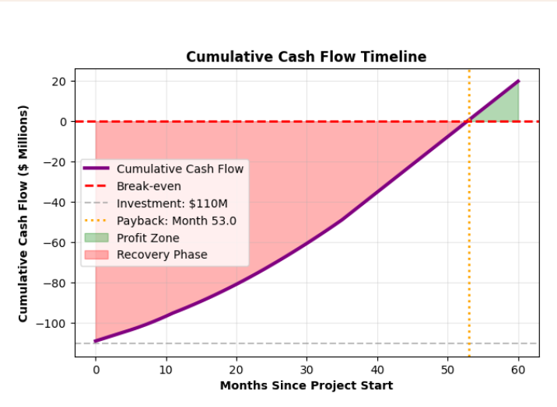
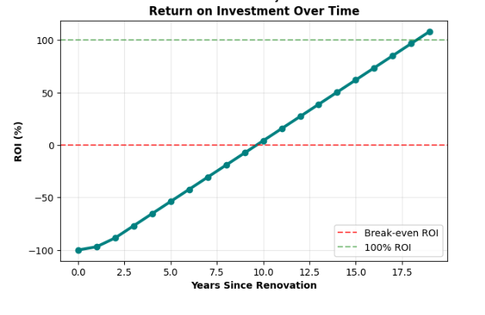
Projections*
*Based on Appendix A’s assumptions

Slide 15
Thank you.

Slide 16
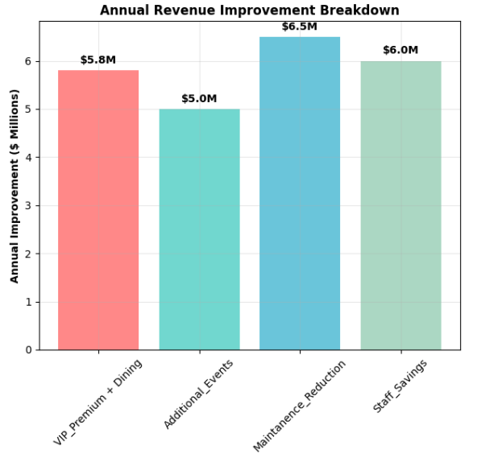
Appendix A
In light of the new stadium, we project the following: Increased revenue comes from:
'VIP_Premium + Dining': # $5.8M from new VIP suites (+15%*)
'Additional_Events': # $5.0M from more concerts/events (est.)
'Maintanence_Reduction': # $6.5M from maintenance (-80%)
'Staff_Savings': # $6M from staff. (+15%)
These numbers are based on estimates and *industry standards.

Slide 17
Appendix A - Funding Structure
Debt (52%) ~ $75,000,000 at 5% APR for 30 years
Corporate Equity Partnership (35%) ~ $105,000,000
Naming Rights & Premium Sponsorship (12%) ~ $40,000,000 (recent case of Telus deal with BC place costing 45 million)

Slide 18
**Calculations & Formulas - Premium Revenue
Premium Percentage = (Premium Revenue ÷ Total Revenue) × 100
Premium Revenue = $2,336,217
Total Revenue = $32,545,368
Premium Percentage = ($2,336,217 ÷ $32,545,368) × 100
Premium Percentage = 0.0718 × 100
Premium Percentage = 7.18%

